Slide 1
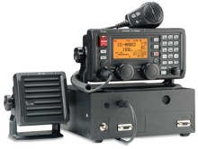
Icom M802 - SSB

Slide 2
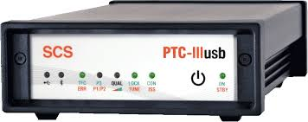
SCS Pactor Modem

Slide 3
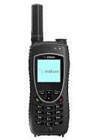
Iridium Handheld Satphone

Slide 4
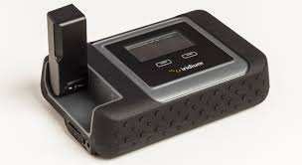
Iridium Go!

Slide 5
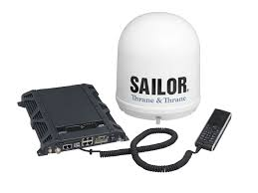
Fleet Broadband

Slide 6

Fleet Broadband Service

